Slide 1
Assembly
You’re not alone
27.01.21

Slide 2
First we will listen to a short story (2 mins).
https://www.youtube.com/watch?v=-RXF5-29VGU&feature=emb_logo

Slide 3
Let’s think about the story.
Why did her hair change colour? What did this represent?
How did she feel when her hair was blue? why
How did she feel when her hair was red? why
How did she feel when her hair was green? Why
Have a chat with someone at home about this.

Slide 4
You’re not alone.
It’s ok to feel a bit fed up sometimes, to have a blue day.
It’s important to talk to someone.
Think of positive things or things that make you happy.
Focus on something that interests you.
Keep busy and keep active.

Slide 5
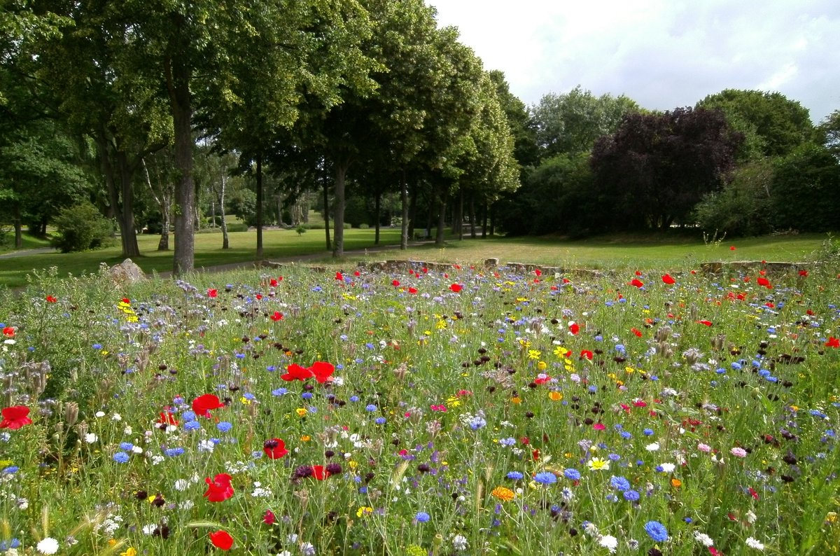
Things we can do to help us feel happy.
Go outdoors. It’s so important to spend time outside. Stop to look at nature. See, hear, smell, feel.
Keep a positive/gratitude journal. Each day write something that you are thankful for or pleased about.
Be creative. Draw, make, colour/paint, build with lego. Use nature or recycling.
Play a game and have fun,

Slide 6
Let’s celebrate
Thinking about positive things makes us happy.
What have you done that you are proud of?
What have you learnt?
What have you improved?
Have you worked hard?
I have sent certificates this week and have lots more to send home.

