Slide 1
PSHE and Citizenship
Living in the Wider World | Diverse Britain
PSHE and Citizenship | UKS2 | Living in the Wider World | Diverse Britain | Identities | Lesson 1

Slide 2
Celebrating Difference

Slide 3
The Big Questions

Slide 4
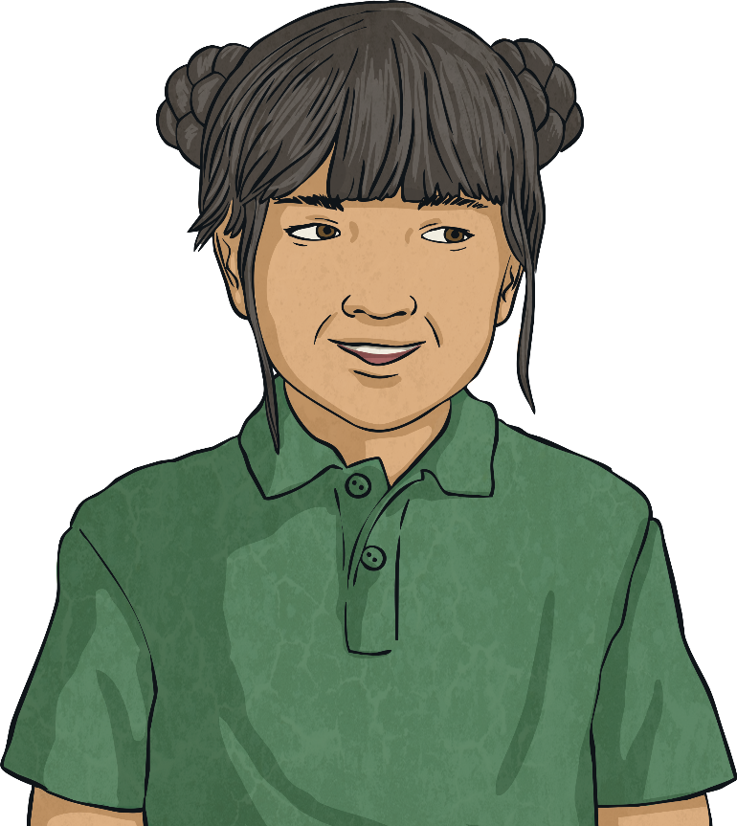
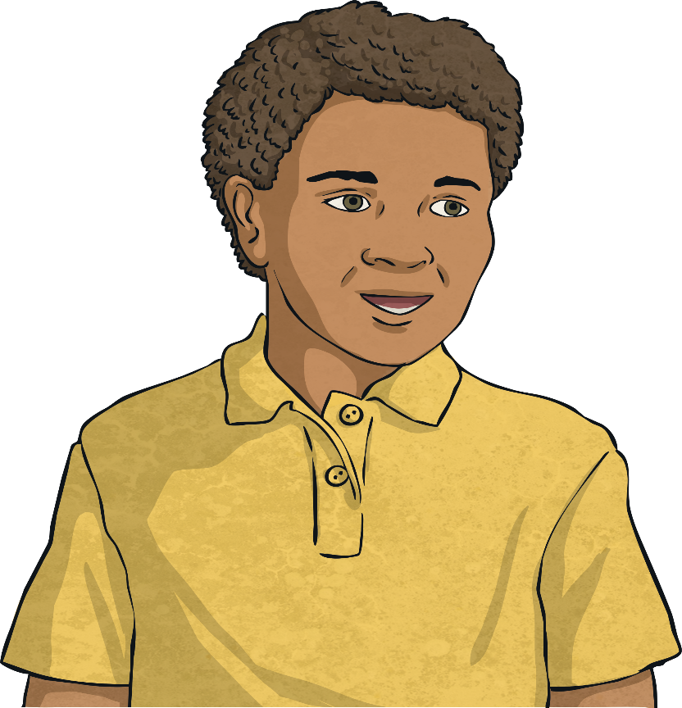
What kind of people live in our nation?
How can we show respect for people whose lives are different to ours?

Slide 5
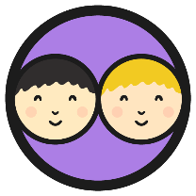
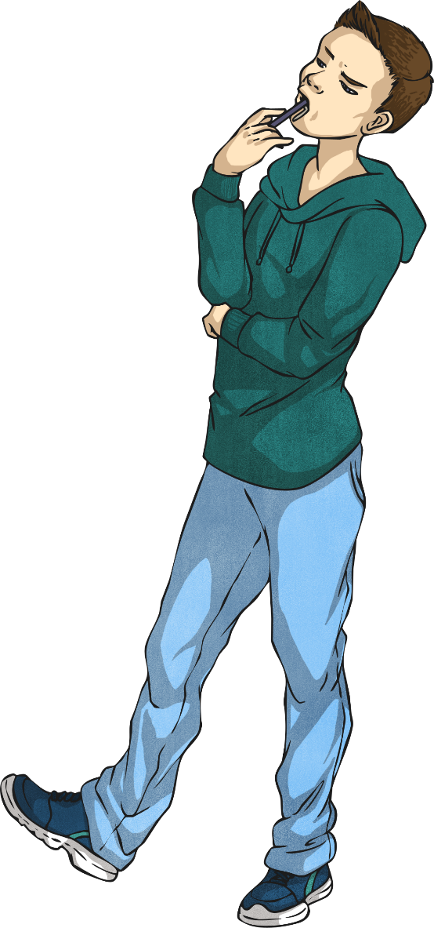
British People
What kind of people do you think live in our nation?
Task 1
Write/draw your thoughts onto a separate page- be creative with this
(an example of how you might lay this out is on the next slide).

Slide 6
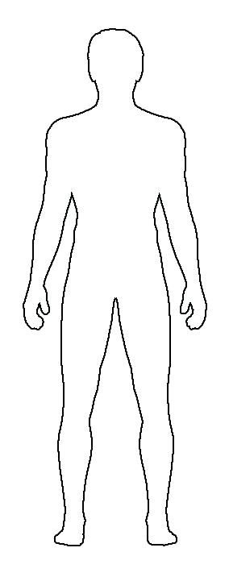
Idea Page
People of different races
Tall people
People in wheel chairs
People with different sexual orientations
Christians
Muslims
People who are deaf
People of different races
You may want to lay your ideas out in a person or flag template. Maybe in the outline of Great Britain?
You may want to draw pictures to represent your thoughts.
Think of as many ideas as you can of different types of people that live in our nation.
Black people
White people

Slide 7
British People
What kind of people do you think live in our nation?
Look at all of your ideas.
What do you notice?
Hopefully you notice what a diverse nation we live in!
Why do you think this is something to be celebrated?

Slide 8
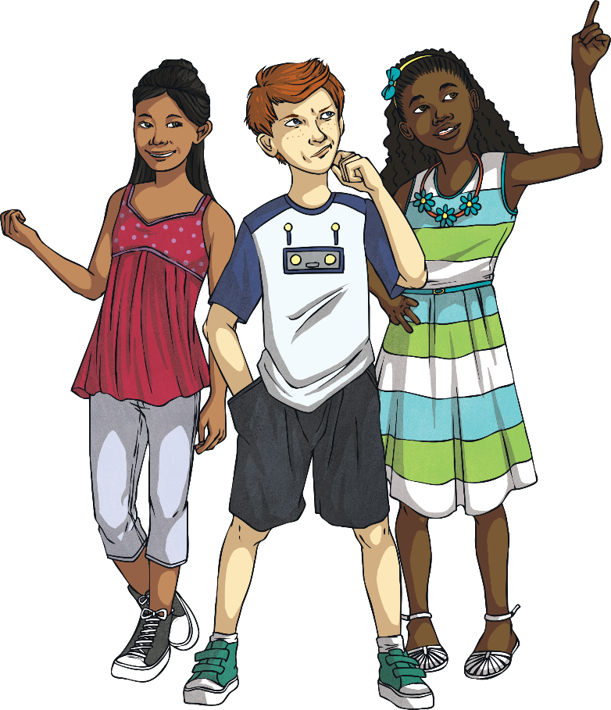
Our nation is a diverse society.
This means that there are many differences between the people living here. There are people of different cultures, traditions, sexual orientations, genders, mental and physical abilities, beliefs, religions and ethnicities. This is something which makes our nation an exciting place to live. Diversity helps us to learn and grow as people. It is something to be celebrated.
Our nation is also a democracy.
This means there is a belief in freedom and equality between all people and that the British government is based on this belief.

Slide 9
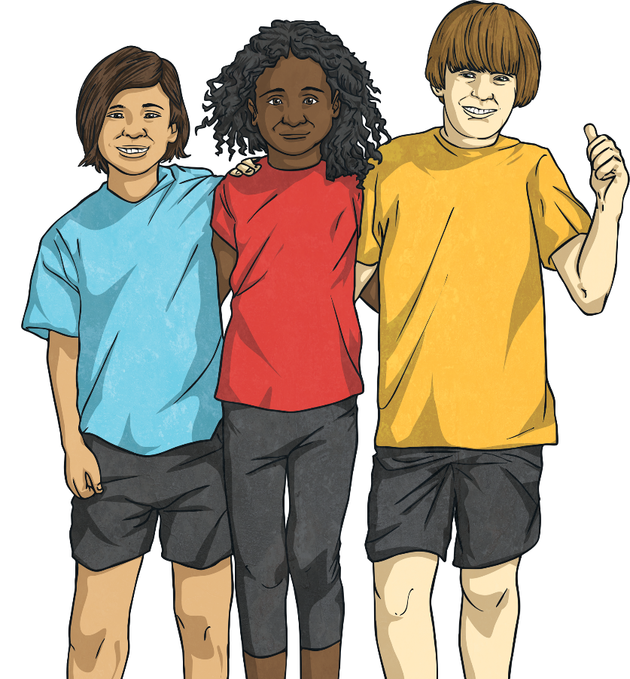
Respect
Every human has the right to live a safe, happy, healthy and fulfilling life no matter who they are, where they are from or how they choose to live their life. It is all of our responsibility to help the rights of others in our community and throughout the world to be met.
Being British is about respecting and valuing each other’s differences and treating all people with kindness. This is something to be very proud of!

Slide 10
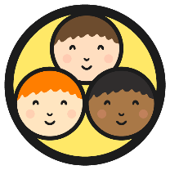
Respect
We have seen that there are people of many different people living in our nation.
It is important to show respect to everyone!
Task 2
Try to answer these questions. Record your thoughts in any way you choose speak to someone, on paper or pictures etc.
What is respect?
What different ways can we show respect to others?
Why is showing respect to all people, whatever their faith ethnicity, sexual orientation, race, etc. important?
How does showing respect to others make them feel?

Slide 11
Respect
We can show respect to others by accepting who they are, where they come from and what they believe and how they live their life.
We can smile and be friendly to all people, wherever they come from or whatever they do.
We can take time to find out about people, asking them questions about their way of life.
Showing respect to all people, whatever their faith, race, sexuality or ethnicity can help make our country a happier, more harmonious place.
We can also learn a lot from our differences too. We are very fortunate to live in such a diverse nation.
Reflecting

Slide 14
Task 3
Have a think about these questions

Slide 15
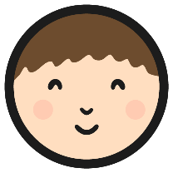
Showing Respect
Task 4
Showing respect to all people, however they live their life, has a positive impact.
Design a poster to encourage others in your community to show respect to everyone, explaining how to do this and why it is important.
What information are you going to include on your poster?
What images are you going to include?
How are you going to set it out?
Word Bank:
respect
faith
difference
similarity
ethnicity
consequence
impact
positive
discrimination

Slide 16
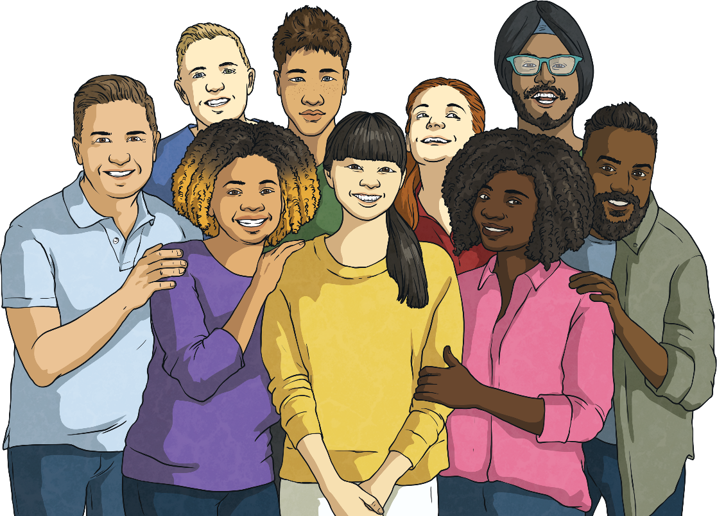
How Does It Feel?
Showing respect to others, those who are similar and those who are different, has a positive impact. Let’s all choose to be respectful of all people and their way of life and make a positive difference to the nation we live in. All people are equal, no one person or group of people is more important, special or deserving than another. It is the right of all people to live a happy, safe, healthy and fulfilling life and it is all of our responsibility to do all we can to protect the rights of all human beings.

