Slide 2
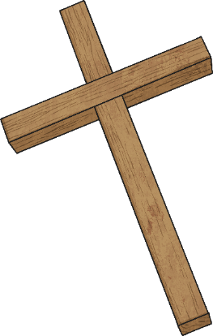
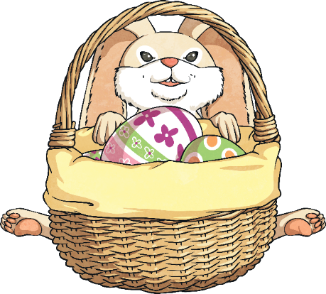
What Is Easter?
Easter is a celebration full of fun, happiness, colourful Easter eggs, cute bunnies, and spring lambs!
But Easter is also an important religious celebration for Christians. It is a time to remember Jesus’ suffering and how he rose again.
The week leading up to Easter Sunday is called Holy Week. There are several important days during Holy Week.
Maundy Thursday (when The Last Supper happened)
Good Friday (when Jesus died on the cross)
Easter Sunday (when Jesus was resurrected)

Slide 3
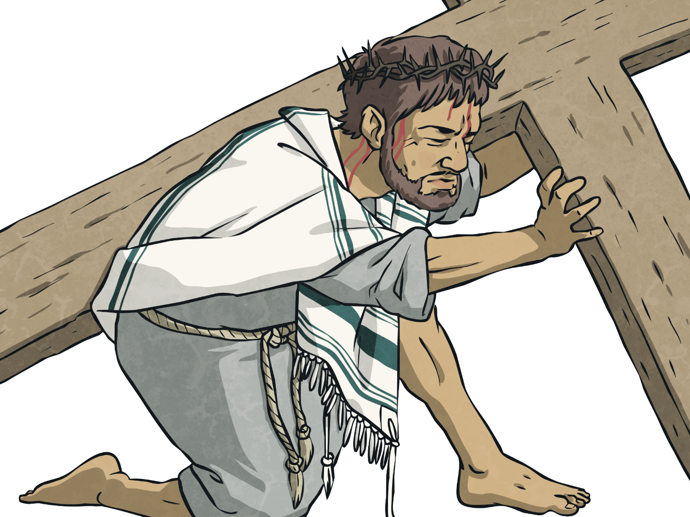
Cross
Jesus was crucified on a cross. Christians believe He rose again after His death to be with God in Heaven.

Slide 4
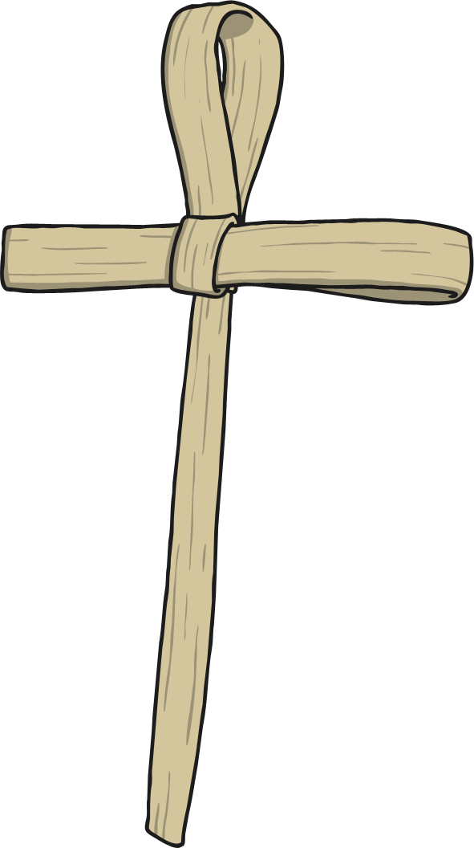
Palm Branches
When Jesus entered Jerusalem, crowds of people welcomed Him and waved palm branches as He passed by. Today, many churches make palm crosses out of palm leaves to remember His arrival in Jerusalem.

Slide 5
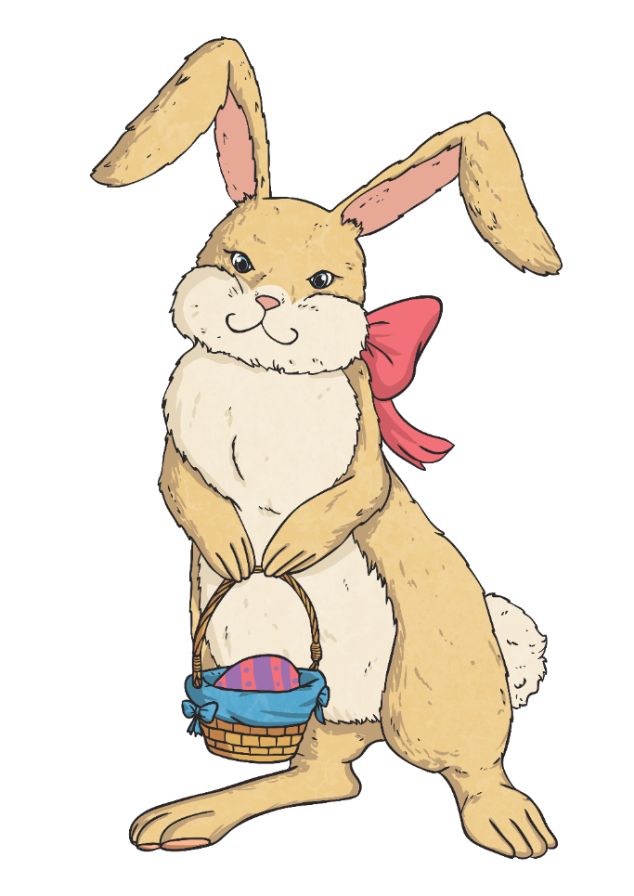
Easter Bunny
Some people believe that rabbits and hares are a celebration of Easter because they symbolise new life in springtime.
Today, many people have their eggs delivered by the Easter bunny to celebrate Easter and the new life which it stands for.

Slide 6
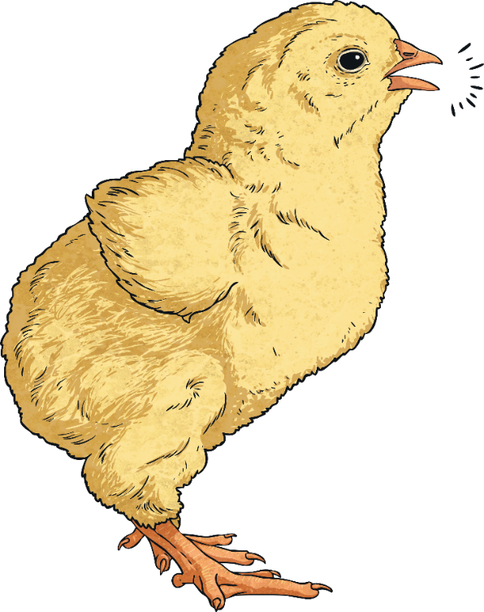
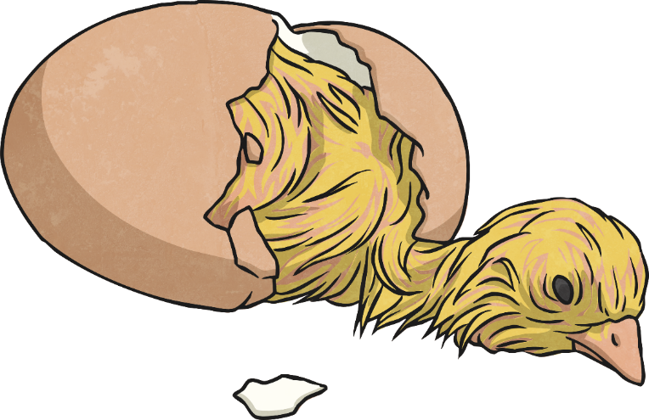
Chicks
Similar to bunnies, chicks hatching are said to symbolize new life.

Slide 7
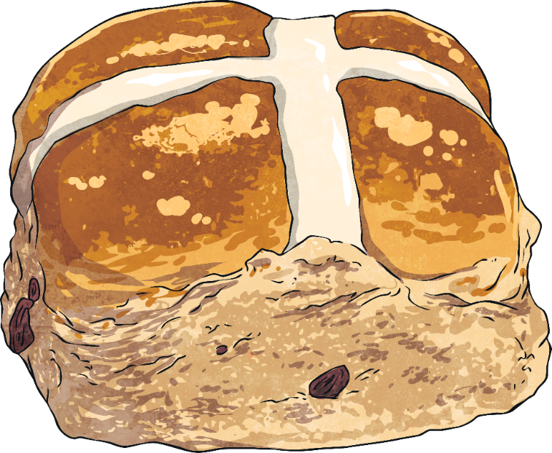
Hot Cross Buns
Tasty, sweet bread rolls, baked with raisins and spices, are commonly eaten during Holy Week. They are marked with a cross to symbolise the crucifixion of Jesus.

Slide 8
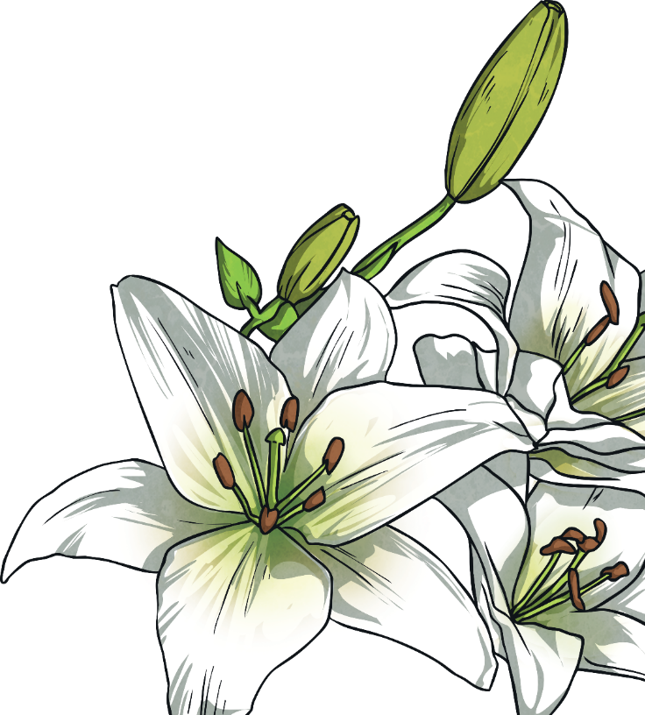
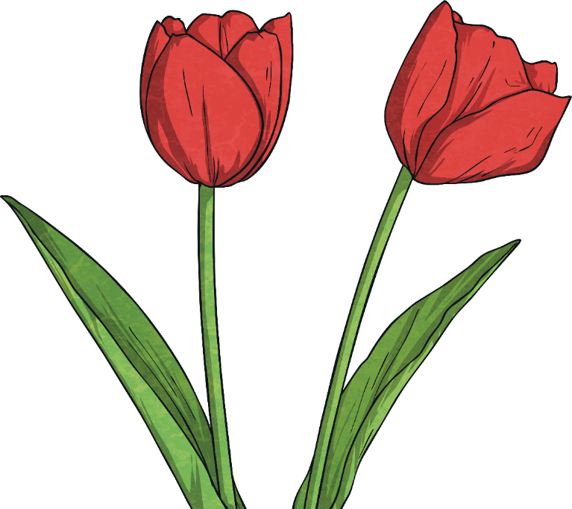
Flowers
Easter lilies have white blossoms which represent the purity of Jesus.
Lilies and tulips bloom in spring; a beautiful display of new life. They are often used in flower arrangements in churches during Holy Week.

Slide 9
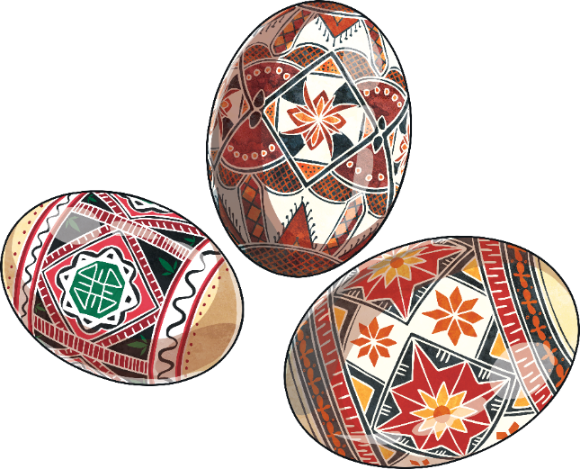
Easter Eggs
Traditionally, Easter eggs are painted chicken’s eggs. Eggs also symbolize new life because of chicks growing inside them. This links to when Jesus emerged from the tomb and came back to life.
Easter eggs today are often made of delicious chocolate and filled with toys and candy!
Some countries still have finely painted eggs, like these beautiful examples in Romania.

